Slide 1
ICT & Software Engineering
05 – Classes & Objects
Constructors & UML

Slide 2

Content
Topics of this lecture
Refresh of last lecture about Classes & Objects
Continuation of Classes & Objects
UML Class Diagrams

Slide 3
Classes Recap
Instance variables & Methods

Slide 4

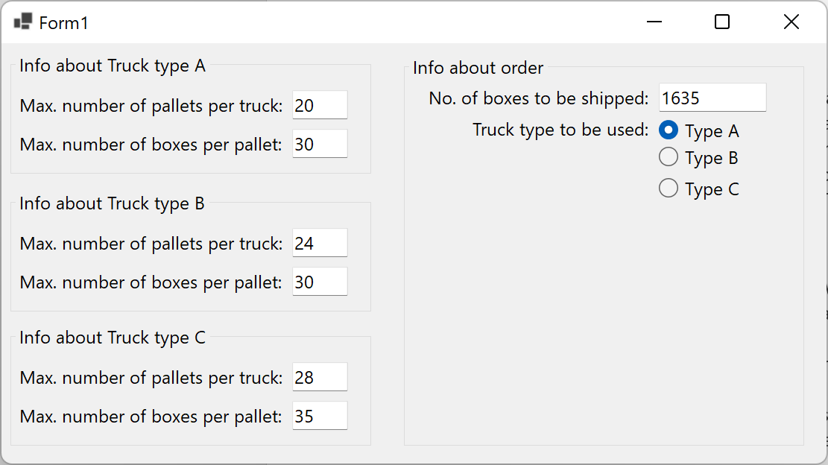
Lesson 02 assignment 05: Truck management (1/3)
Without classes it becomes trickier to extend the Truck application of lesson 2!
What challenge are there when:
We want to allow a user add new trucks?
We want to add additional data to a truck?
We want calculate shipping costs based on the selected truck?
We want to also offer a web interface?
…?

Slide 5

Lesson 02 assignment 05: Truck management (2/3)
How can we refactor this application to make use of classes?
For now, only worry about ‘making’ one class:
What entity would this class represent?
This would the name of your class
What should we be able to do with this entity?
These would be the public methods of the class
What data is required to perform these actions?
These would be the private instance variable of the class
Are there actions which have partially overlapping logic?
These would be the private methods of the class

Slide 6

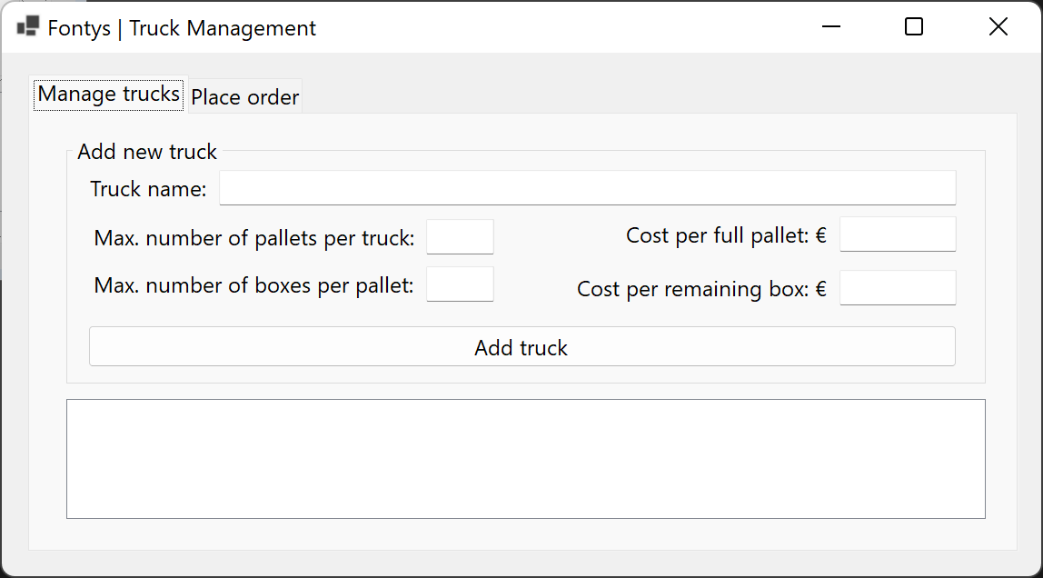
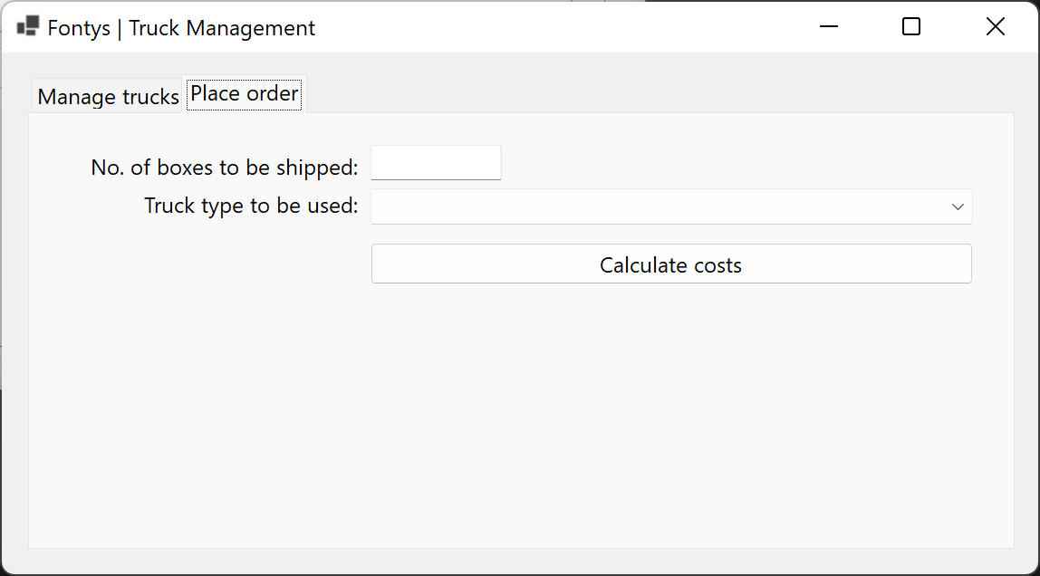
Lesson 02 assignment 05: Truck management (3/3)
Create the class refactor your application to make use it.
Do this individually and after this we will together extend one student’s Truck class to:
Allow a user to add new trucks
Calculate shipping costs based on the selected truck

Slide 7

Questions?

Slide 8

Variables: value & reference types
Variable with a value types
Actual value is ‘stored’ in the variable.
Simple types, such as int, string, bool, etc., are value types
Variable with a reference types
The memory address (pointer) is stored in the variable.
Complex type, such as objects, are reference types
int numberA = 1;
int numberB = numberA;
numberA += 5;
// What is the value of numberA?
// What is the value of numberB?
// Car has a field model with a get and set method
Car carA = new Car();
Car carB = carA;
carA.SetModel("Porsche 911 Turbo");
// What is the value of carA.GetModel()?
// What is the value of carB.GetModel()?

Slide 9
Classes Continued
Constructors and overloading

Slide 10
Intro: initializing an object
public class Car
{
private string model;
private int topSpeed;
private int speed;
public void SetModel(string model)
{ this.model = model; }
public string GetModel()
{ return this.model; }
public void SetTopSpeed(int topSpeed)
{ this.topSpeed = topSpeed; }
public int GetTopSpeed()
{ return this.topSpeed; }
public void SetSpeed(int speed)
{ this.speed = speed; }
public int GetSpeed()
{ return this.speed; }
...
public class Car
{
private string model;
private int topSpeed;
private int speed;
public void Initialize(string model, int topSpeed)
{
this.model = model;
this.topSpeed = topSpeed;
this.speed = 0;
} public string GetModel()
{ return this.model; }
public int GetTopSpeed()
{ return this.topSpeed; } public int GetSpeed()
{ return this.speed; }
...
Car myCar = new Car();
myCar.SetModel("Porsche 911 Turbo");
myCar.SetTopSpeed(320);
myCar.SetSpeed(0);
Car myCar = new Car();
myCar.Initialize("Porsche 911 Turbo", 320);

Slide 11
Intro: Constructors
When an object is created, the constructor of a class is ‘called’
A class definition always has a constructor. For example, this class Person with no members:
We can replace the default constructor by defining our own
The (hidden) default constructor for this class is:
public Person()
{}
class Person
{
}

Slide 12

Examples
public class Car {
private string model; private int topSpeed; private int speed;
public Car(string model, int topSpeed) { this.model = model; this.topSpeed = topSpeed; this.speed = 0; }
public void SetTopSpeed(int topSpeed) { this.topSpeed = topSpeed; }
public void SetSpeed(int speed) { this.speed = speed; }
...
Own constructor

Slide 13

Syntax
<access_modifier> <class_name> (<optional_list_of_params>)
{
<constructor_body>
}

Slide 14
Questions?

Slide 15
Extra information
No type or void-keyword required
Same name as class
No constructor specified?, then there is a default constructor that takes no parameters
Custom constructor replaces the default constructor
There can be multiple constructors, but they require different types/order/number of parameters
Constructor overloading
Why do you think this is useful?

Slide 16
Intro
What if you want to perform the same action(/method) with an object, but with different parameters?
For example:
Increase the speed of a car by X or increase it in steps of 5
Initialize the car object with a speed of 0 or with a starting speed of X
This is possible by overloading a method or constructor

Slide 17
Syntax for constructors & methods
Rules for overloading:
Define a constructor/method in the class with the same name, but with at least ‘different’ parameter(s)
public void DummyMethod() { // Some code }
public void DummyMethod(string caption) { // Some code }
public void DummyMethod(int caption) { // Some code }
public void DummyMethod(string caption, string body) { // Some code }

Slide 18
Examples
How can you call the correct overloaded constructor/method?
Example obj = new Example();
obj.DummyMethod();
obj.DummyMethod( "Hello", "World!" );
string caption = "Hello";
obj.DummyMethod( caption );
public class Example {
public void DummyMethod() { // Some code }
public void DummyMethod(string caption) { // Some code }
public void DummyMethod(int caption) { // Some code }
public void DummyMethod(string caption, string body) { // Some code }
}

Slide 19
Questions?

Slide 20
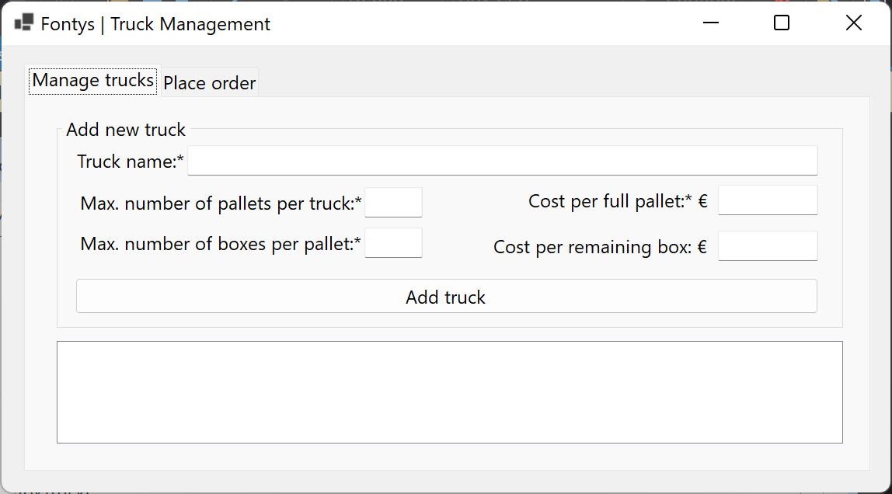
Demo: Extend Truck app
Include overloaded constructors:
Initialize Truck-object with all data
Initialize Truck-object without costs of remaining boxes
How would we be able to calculate that costs in the constructor?

Slide 21
Extra information
Good practice: be consistent with the input parameters and the method(s) should do the same!
public void Write(string message, Object target){} public void Write(string line, bool appendNewLine, Object o){}
public void Write(string message, Object target){}
public void Write(string message, Object target, bool appendNewLine){}

Slide 22
Practice: Extend Truck management
Extend your Truck Management app
With the ability to search a truck by its name
Show info about found truck
Possibility to delete the found truck

Slide 23

What to do next?
Start working on the practical

Slide 24
Part2 – Practical
See canvas for Quiz & practical assignments

Slide 25
Part 3
UML Class Diagrams

Slide 26
Questions about practical?

Slide 27
Content
Topics of this lecture
Continuation of Classes & Objects
UML Class Diagrams

Slide 28
Intro: Why a diagram?
What entity would this class represent?
This would the name of your class
What should we be able to do with this entity?
These would be the public methods of the class
What data is required to perform these actions?
These would be the private instance variable of the class
Are there actions which have partially overlapping logic?
These would be the private methods of the class
‘Standardized’ way of depicting the answers to these questions for all involved developers

Slide 29
Intro: Why?
Conceptual
Able to design an architectural overview of an application based on desired requirements
Specification
Able to specify methods and fields for classes based on a description
Implementation
The programming trick/being able to write code based on supplied specifications
As a software engineer you should be able to do all three!
UML Class Diagram is one of the tools you can use

Slide 30
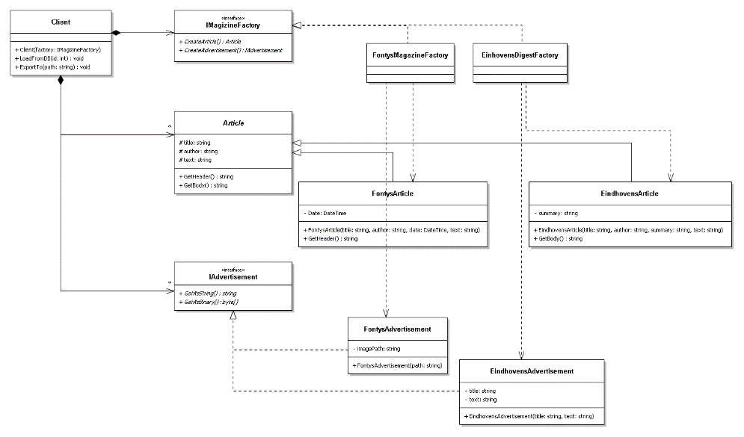
Intro: UML Class Diagram
Unified Modelling Language (UML)
Represent classes in a structured, visual way.
A class diagram contains all classes and the relations between them
Each class has fields and methods
Each class may have a different types of dependencies
For now, we focus on classes and two types of relationship

Slide 31
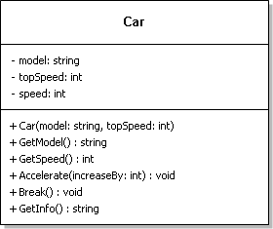
Examples
Class name
Instance variables
Constructor
Methods
This diagram cand be translated to code. Some tools can do this for you!

Slide 32
Syntax
<Class_Name>
<access_modifier> <field1_name>: <field1_type> <access_modifier> <field2_name>: <field2_type> <access_modifier> <field3_name>: <field3_type> <access_modifier> <field4_name>: <field4_type> ...
<access_modifier> <Class_Name>(<optional_list_of_params>) <access_modifier> <method1_name>(<optional_list_of_params>): <return_type> <access_modifier> <method3_name>(<optional_list_of_params>): void ...
Comma (,) separated
(<param1_name>:<param1_type>, <param2_name>:<param2_type>)
For now
+ : public
- : private

Slide 33



Extra information
A class diagram usually contains multiple classes. It is important to mention the relation between the classes
These relations are called associations; depicted as arrows representing the navigation direction.
For example:
A car has 4 wheels;
A child can have 0 to 2 parents;
A class list has 0 or more students.
How would this translate to C# code?

Slide 34
Demo
Create a UML Class Diagram based on the Truck-class

Slide 35
Questions?

Slide 36
What to do next?
Continue working on the practical

Slide 37

Summary
After this lecture you can:
Work with Classes and Objects in C#
Use instance variables and methods in a class
Know when to use public of private

